Slide 1
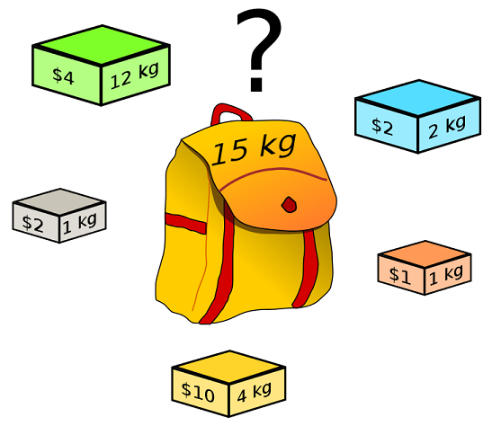
Max Knapsack NP-Complete Project Presentation
By Trevor Woodman, Joe Drake, Patrick Glebus, and Jacob Hataway

Slide 2
Bounded Max Knapsack
The Decision Problem:
Given a knapsack that can hold some maximum positive weight w, a target value v, and a list of items, each with a unique name, a weight, a value, and a maximum amount of copies of the item, does there exist a combination of items that achieves a value of at least v, while not exceeding weight w?
The Optimization Problem:
Given a knapsack and a set of items as described above, what combination of items achieves the maximum value possible, while not exceeding weight w?

Slide 3
Problem Input and Output
Input:
The input will begin with a single line containing a nonnegative integer weight w, representing the maximum capacity of the knapsack. This is followed by a single line that contains a nonnegative integer n followed by exactly n lines each of which contains four items (String, real, real, int). The first value is the item's name, the second is the dollar value of the item, the third is the item's weight, and the fourth is the availability bound on how many of that item you can put into the knapsack.
Output:
The output begins with a list of items in the knapsack, each with its name, value, and weight. The final line is the total value of items in the knapsack, formatted to two decimal places.
16 # Maximum weight of knapsack
3 # Amount of items
ring 100 5 2 # Name, value, weight, availability
gold 50 10 5
silver 50 5 1
ring 100 5 # Name, value, weight
silver 50 10
gold 50 1
200.00 # Total value of knapsack

Slide 4
Reduction (justify its inclusion in NP-Complete)
Show the reduction that justifies the problem is in NP-Complete

Slide 5
An explanation of pseudo-polynomial time
Why this problem looks polynomial but isn’t

Slide 6
Sketch of Exact Solution (pseudo-code)

Slide 7
Worst Case Example (if possible)

Slide 8
Test Cases
How did you generate them? (hopefully with a python program)
Test case Sizes?
Performance of test cases of different sizes?
Plot of the run time of your program as you increase the input size. You MUST run your program on inputs that cause your program to run more than 20 minutes.

Slide 9
Approximation Portion
By Trevor Woodman, Joe Drake, Patrick Glebus, and Jacob Hataway

Slide 10
Approximation
Sketch algorithm choices (anytime algorithms, greedy algorithms, stochastic algorithms).
Bounds on its performance
Plot comparing difference in run time and solution quality using your test cases.

Slide 11
Approximation Explanation
For solving the approximation, we use fractional knapsack to help us construct it
We assume for simplicity that all items individually fit in the sack. We first construct a list which we call S1. S1 will contain a list of {1,...,k} where k equals the last element that doesn’t exceed the total weight. Given this we continue to pack items greedily as long as possible until we exceed the total weight. Once we exceed the total weight we construct a second solution S2 will contain the list of {k+1} which is the first item that did not fit in S1.
Since S1 union S2 provides the upper bound for the Linear Programming Relaxation Problem, one of the sets (S1 or S2) must have at least (max)/2. Therefore, we return whichever of S1 and S2 that contains better value to obtain a valid ½-approximation.

Slide 12
Non Optimal Input Example
In the example below, the input given does not give the optimal choice
300
3
ring 280 200 2
diamond 280 200 2
ruby 300 300 1
We expected to get an output of one ruby but instead get a output of one diamond.
This is because it will first get the ring for bag a, and then mark diamond as the first one to be added and then it can’t add ruby
and then it’ll add diamond
to bag 2 and bag 2 cant add ruby at that point

Slide 13
Upper Bounds
The upper bound for bounded knapsack is
S = max (S1, S2)
We came up with this because S1 U S2 provides the upper bound
The time complexity for the computation of U1 or U2 is O(n) if the item types are already sorted. If the items are unsorted then we add O(nlogn) for sorting

